Slide 1
An Infrastructure Product Model Putting the Ops in DevOps
Steve Farley
VP, Infrastructure & Operations
Nationwide
October 5 – 7, 2021

Slide 2
An Infrastructure Product Model
Putting the Ops in DevOps
Steve Farley VP Infrastructure and Operations, Nationwide Insurance

Slide 3
Putting the Ops in DevOps – An Infrastructure Story
Nationwide’s technology organization has a long history of applying DevOps principles to software development. Now, we’re infusing DevOps into infrastructure engineering. Come learn how we’re putting the “Ops” in DevOps.
During this session, you’ll:
Learn about the guiding principles and playbooks used to integrate DevOps product principles to improve how Nationwide builds, ships, and runs infrastructure in partnership with software teams.
Gain perspective about product taxonomy and the complexity of defining products in a world that consists of business products, software products, platform ass a product and the journey maps and customer experiences they enable.
See how the equation of Lean+Agile+DevOps is being implemented for infrastructure teams and how we transformed the way we price and deliver infrastructure at Nationwide.

Slide 4

Steve Farley, VP, Infrastructure and Operations, Nationwide
Steve has over 30 years of IT experience with a focus on delivering technology solutions to meet the needs of our business. He earned his bachelor’s degree in Computer Technology from The Ohio State University, and holds his FLMI insurance designation.
Fun facts about Steve: His wife Dana is also a Nationwide associate, and his father-in-law is a retired Nationwide Agent. Steve and Dana have two children and live on a small 35-acre farm where they are active in the American Quarter Horse Association (AQHA) as breeders and exhibitors across the country.

Slide 5

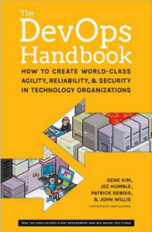
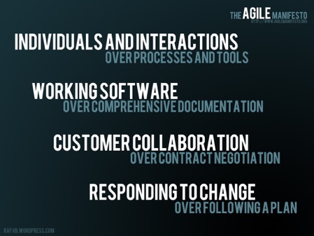



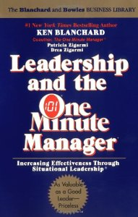
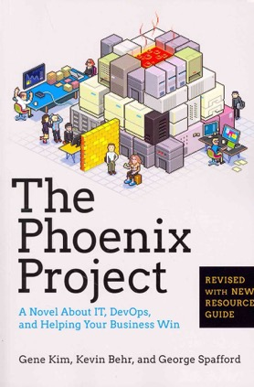
Recent Influences

Slide 6
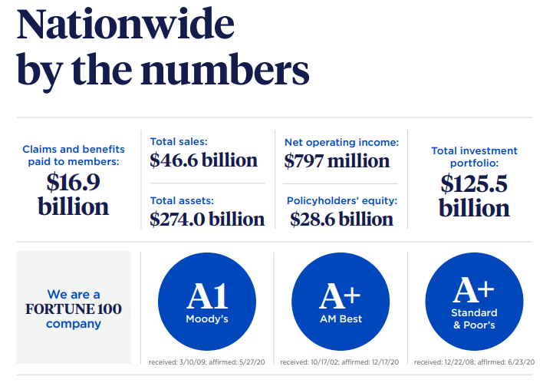
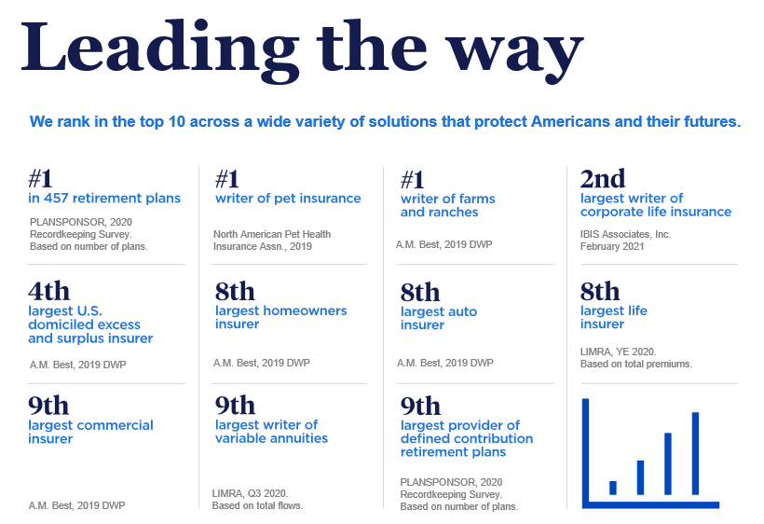
Who is Nationwide?

Slide 7

Nationwide Technology
8,400+
301+
Technology Workforce
Associates & Contractors
Agile Dev Teams
$1.3B
55+
60+
2,700+
Annual IT Spend
Primary Technologies
Infrastructure Product Teams
Applications

Slide 8

Nationwide’s LEAN+Agile+DevOps Journey
2020
Infrastructure Product Centric Model
2016
DevOps launched
2015
Infused Test
Automation
Focus
2018
86% of 200+ Teams are mature in Agile
2013
Lean Application
Maintenance launched
2015
Establish Software Development Services, 40% Agile Adoption
across 200 Teams
2014
50 Agile Development Teams
2011
Agile Development
Center established,
10 Teams
Pre-2011
Local Agile
experiments
Notes:
Guru

Slide 9
Agile methods form the basis of our software development practices, Lean provides the structure to manage Agile at scale
Agile Principles
Highest priority is customer satisfaction
Welcome changing requirements
Frequent delivery of software
Business people & developers cooperating daily
Face-to-face conversation is best
Progress measured by working software
Sustainable development pace
Continuous attention to technical excellence
Simplicity
Self-organizing teams
Regular reflection & adaptation
Lean Principles
Eliminate waste
Build quality In
Defer commitment
Deliver fast
Create knowledge
Respect for people
Optimize the whole
Agile
Lean
Test-first programming
Pair programming
Gemba Walks
Standard Work
Accountability
Visual Management
Stand-ups
Continuous Improvement
Knowledge Sharing
Metrics
Simple design
Sharing codebase
between programmers
Rigorous, regular refactoring
Continuous integration
Single coding standard
Common “war-room”
style work area
Poppendieck: Lean Software Development
Notes:
Kevin

Slide 10
DevOps Transformation Journey
Our DevOps journey started around 2016 as we were well on our way with Agile adoption. We had to sell our executives on the intent behind DevOps and its value beyond traditional Lean and Agile adoption.
Specific Techniques that Drove Adoption
Built model lines to infuse DevOps Handbook techniques and test them in our environment
Allowed other teams to Gemba walk and learn the concepts.
Extended our learning culture with conferences and weekly practitioner teaching sessions called Teaching Thursdays as illustrated in Chapter 21 of the DevOps Handbook.
We built adoption best practices and guiding principles so teams could pull themselves forward.
We had grass roots DevOps forums and continued to use our ScrumMasters to bring DevOps principles into over 225 agile teams at Nationwide.
Visual Marketing included a DevOps Summit with DevOps Handbook reading clubs at the basecamp of our journey.
Metrics
Key DevOps metrics were infused in our model focused on Mean Time to Restore Service (MTRS), release frequency, speed to market and change success. We also infused adoption metrics for teams to measure themselves.

Slide 11





Making Sense of Industry Best Practices Lean, DevOps, Agile & Architecture IT Enable Multi-Speed IT Delivery
LEAN
Visual workflow management
Root-cause problem solving
Eliminating waste
Leaders’ engagement
PURPOSE
MULTI-SPEED IT DELIVERY
Capability to ID & solve problems
Recognition of different speed based on different value propositions
Requires adaptive business mind-set
PEOPLE
PROCESS
AGILE
Scrum
XP
Faster build cycles
Embrace change
Drives Need
Systems of Record
Optimize
Systems of Engagement
Innovate
DEVOPS
Automation
Continuous delivery
Continuous feedback
Engineering components of Lean IT
Drives Investment
ARCHITECTURE DRIVEN IT
Standard platform
Simple, API enabled
Standard Architecture

Slide 12

What did DevOps Mean to Nationwide The Horizontal Mindset
IT delivery model
Plan
Build
Run
Shift from vertical practices to horizontal improvement
DevOps is a set of practices and mechanisms that facilitate continuous delivery in support of a lean management system in recognition of multiple speed IT

Slide 13
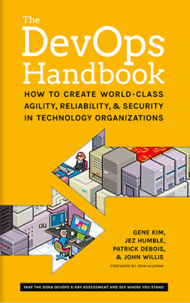
Experiment Guiding Principles
Version control everything
Fast and reliable automated tests
Continuous integration to the trunk
Automated infrastructure
Automate/enable low-risk releases
Architect for low-risk releases
Monitor everything

Slide 14
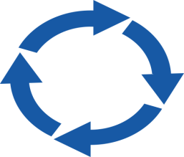
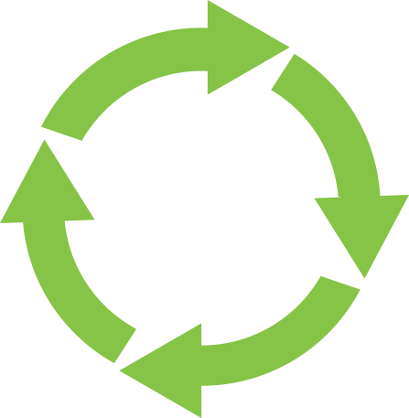
LifeCycle Journey Through past & present – The move to Infrastructure
CIRCA 2000
NO STANDARD METHODOLOGY
NF
WATERFALL
REQUIREMENTS
MANUAL ENVIRONMENTS
PROJECT PLANNING
PROJECT ARCH
PHYSICAL HW PROVISIONING
NSC
DESIGN
DEVELOPMENT
NI
MANUAL TEST
MAN. DEPLOY
INCONSISTANT RELEASE PROCESS
CIRCA 2010
ALIGNED ENTERPRISE AGILE BUILD PRACTICES
DEV ENVIRONMENT PROVISIONING
INDIVIDUAL BSA PORTFOLIO PLANS
ITERATIVE SOLUTION SCOPING
AGILE DDT
SOME AUTOMATED TESTING
INFRASTRUCTURE
Automation
ONE- IT
IT DELIVERY MODEL
ENTERPRISE REFERENCE ARCH
MANUAL DEPLOYMENT
WATER -------- SCRUM -------- FALL
4-2-1 RELEASE PROCESS
CIRCA 2020
MOVE TO CONTINUOUS DELIVERY WITH DEVOPS
DYNAMIC ENVIRONMENT PROVISIONING
CONTINUOUS PLANNING & PRIORITIZATION
AGILE DDT
MORE AUTOMATED TESTING
Product Centric Infrastructure
INTEGRATED PERSPECTIVE
INTEGRATED PLANS
MICROSERVICES ARCHITECTURE
AUTOMATED DEPLOYMENT
CONTINUOUS DELIVERY

Slide 15
Something was Missing – Infrastructure Teams
Benchmarks indicated Nationwide’s Infrastructure costs where out of alignment with our peer companies
We FORGOT to bring infrastructure teams along in our Lean+Agile+DevOps Journey
Nationwide’s Infrastructure teams wanted to achieve industry leading user satisfaction, unit cost competitiveness, and overall speed to market
Product management principles and mindsets could be the catalyst
We needed to “use all the things” to guide Infrastructure alignment

Slide 16

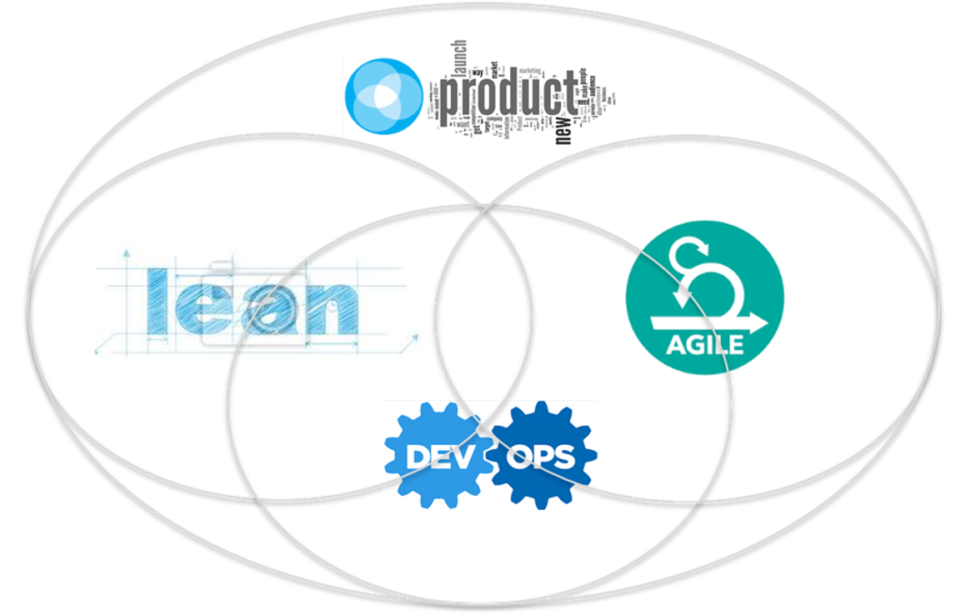
Use All the Things for Infrastructure Teams
DOGMA FREE ZONE
Do NOT get married
To any ONE of these.
Use what is right
for the specific
situation you’re In.
That assumes you (or someone you work
with) understand each
Product ensures you solve the right customer and business problems, while focused on measurable outcomes
Lean challenges us to seek out value and reduce waste
Agile
delivers value incrementally
and drives
efficiency
DevOps adds quality and accountability while enabling automation in engineering; teams run what they build and deploy continuously

Slide 17
Why a Product Centric Operating Model Seems Right
Results from the Industry
Strong emergence and positive feedback in the industry
Product teams demonstrated Lead time owning their entire lifecycle
Better quality from full stack Build IT/Run IT teams with accountability
Better Employee engagement taking work from idea to implementation
Nationwide Challenges:
Understanding PRODUCT from both business and technical product perspective. Align our Product definition.
NW Technology is tightly coupled but decentralized
Business silos drive value stream independence
NW Definition of Software Asset needed aligned
Expense pressures required Efficiency outcomes
How Product Best Practices Would Help
Build product and team design to drive organizational efficiency
Enable Full stack product analysis to drive reduced unit cost
Designing a product taxonomy in partnership with finance to enable product cost and unit cost recovery
Transform how we deliver to improve lifecycle management, velocity, and quality – Lean+Agile+DevOps

Slide 18
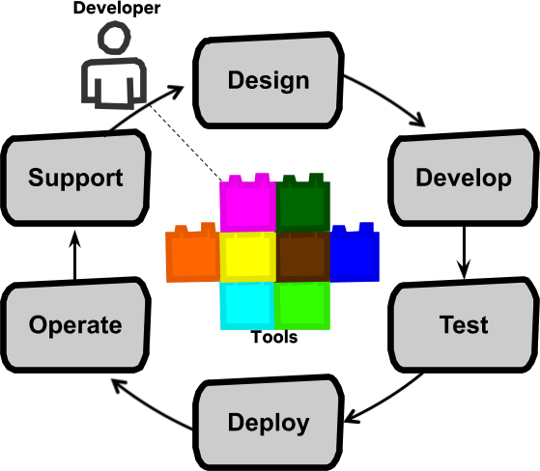




Industry Insight- Product Behaviors Supported Our Goals
START ORGANIZING WORK AROUND PRODUCT NOT PROJECT WORK
FULL CYCLE PRODUCT
People are brought the work
DevOps - optimize for learning and feedback, break down silos
Business idea directly to line reduces churn in requirements
Running what you build creates direct feedback loops
When a build team feels operational pain, they will fix it!
Technical
Product 1
Technical
Product 2
Technical
Product 3
Teams are formed around products, NOT projects
Project work is mixed with other work needed on the PRODUCT to build, Ship, and Run the Product
Source: Project to Product – Mik Kersten
Work is brought to the people
https://medium.com/netflix-techblog/full-cycle-developers-at-netflix-a08c31f83249
PRINCIPLE 1 - Customer-Centric Action
It is critical to receive short feedback loops and constantly invest in end-users by building IT products and services that receives a maximum level of customer delight, while being able to pivot when an individual strategy is not (or no longer) working.
PRINCIPLE 3 -End-To-End Responsibility
IT teams need to organize in such a way that are fully accountable for the IT products or services delivered and provide end to end performance support to its customers.
HOW DEVOPS
PRINCIPLES SUPPORT PRODUCT
PRINCIPLE 2 - Create with the End in Mind
IT Organizations need to act as product companies that explicitly focus on building working products and all employees need to share the engineering mindset that is required to envision and realize those products.
PRINCIPLE 4 - Cross-Functional Autonomous Teams
Vertical, fully responsible teams require a balanced set of skills with T-shaped all-round profiles instead of old-school IT I-shaped subject matters experts.
Notes:
Read the whole paragraph and boil it down to one sentence

Slide 19
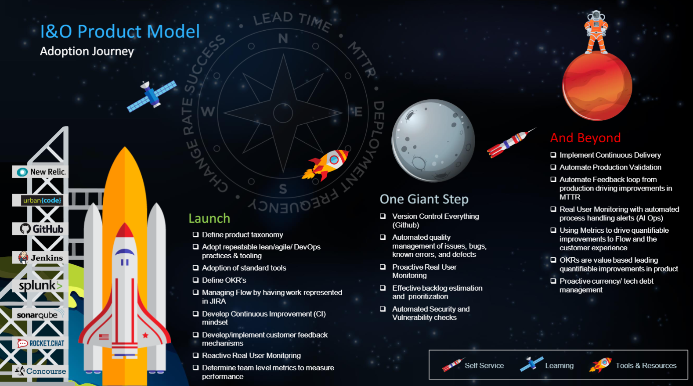
A Product Journey was Launched

Slide 20



Outcomes Expected – Efficiency & Productivity
Labor Related Savings
These savings typically come from organizational alignment, product role alignment, full stack product team structural alignment
Product Stack (HW/SW) Savings
These savings come from ownership and analysis of the full product stack with an optimization focus to reduce unit cost.
Productivity Savings
Typically, hard to harvest but teams become more productive adding speed, quality, and value thus enable new outcomes and reduced backlog of work. We have NOT included these types of savings.

Slide 21


Industry Insight – Many Views of Product of Product
Customer Experiences
Business Products
Software Products
Technical Products
Multi-Quote & Bind
1
MVP 1 (Auto & Home first)
2
MVP 2 (Add Life next)
Life
Identity & Access Platforms
Auto
Retirement Plans
Home
Network
Compute
Middleware
NW.com
Mainframe Platform
DC Direct
ISC
I&O Implemented
Technical Product
Orientation
BUSINESS VALUE STREAMS
TECHNOLOGY VALUE STREAMS

Slide 22

Building Blocks to Product Success
I&O Transformation Design & Execution
Continuous
Improvement
Transformation Approach (Coaching/Dojo/
Self Service, etc)
Tooling to
Support Transformation
Defining and Collecting
Best Practices
(The How Playbook)
Building a Foundation
Organizing for
Product
Implementation
FULL STACK ANALYSIS
Understanding our
Product Values
(The Why)

Slide 23
Understanding our I&O Product Values (The Why)
I&O Transformation Design & Execution
Understanding our Product Values (The Why)
Creating focus and priority
Establishing mindset
Establishing guiding principles
Leverage Lean + Agile + DevOps
Understanding our
Product Values
(the Why)

Slide 24
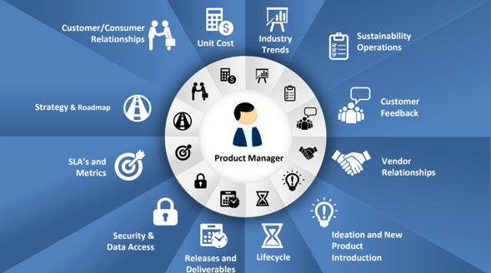
Product Management Mindset – If you’re not accountable for the Product Components you don’t own the Product
Operating with a Product Mindset means having a holistic understanding of product performance, cost, quality, and customer satisfaction.

Slide 25








Nationwide Infrastructure Product Guiding Principles
Enable consistent delivery of extraordinary care
2020 Objective Alignment: Product Centric Operating Model
Establish and operationalize Product Centric Operating Model with a focus on User Feedback, Unit Cost, and Speed
Improve operations for speed, efficiency, expertise
INDUSTRY-LEADING PRODUCTS
AT COMPETITIVE COSTS
DRIVEN BY USER EMPATHY
UNIT COST
FEEDBACK LOOPS
DELIVERING AT THE SPEED
OUR CUSTOMERS NEED
TRANSFORM HOW WE DELIVER
SPEED
LEAN+AGILE+DEVOPS
SECURE AND RELIABLE DELIVERY
COMMUNICATE EARLY AND OFTEN
AVAILABILITY
TRANSPARENCY

Slide 26
Organizing into Product Teams & Product Focus
I&O Transformation Design & Execution
Organizing for Product Implementation
Defining our Product
Organize for Product Focus
Define New Roles – Engineering Profession Alignment
Organizing for
Product
Implementation
Understanding our
Product Values
(The Why)

Slide 27
Infrastructure Product Teams Supported by Services
Many Services teams helping to leverage our “products.” This helps us organize for customer experience and success.
44 Product teams
Key
I&O Product Teams
26 Services Teams
Cross-Cutting, Product Support for BSA Success
I&O Success Team
Partner Solutions
Reliability, Availability, &
Automation Consulting
SRE Community
Compute
Storage
Mainframe
Event Streaming
Messaging
Relational Database
Web/Runtime
Other Cross-Cutting
Services Group that enable product success
I&O Run Services
Vulnerability Operations
Full Stack Product Teams
Architecture
Portfolio Management

Slide 28
I&O Product Design | Technical Product Design Examples
Unitized 60+ Products
At the product level
Departmentalize at the Product Suite level
Organized the products at the grouping level

Slide 29

Products Working in Harmony- Identity and Access Management
Our CISO office defined horizontal products that intersected with Infrastructure Technical Products illustrating different views of product working in harmony*.
IRM Products
Capability Products
I&O Products
Technical/Platform Products
IAM Total Unit Cost is Composed of Two Distinct Groups and the sum of all IRM and I&O Unit Costs
IRM Capability
IAM Authentication Services
IRM Capability
Internal/External IAM Services
IRM Capability
IRM IAM Lifecycle Management: Unit Cost: $98.27 (Internal)
Internal
44k Users
Cost Per ID:
$269
Product Challenges/opportunities
External
7.66M Users
Directory & Certificate Services
Unit Cost: $54.54 (Internal)
$$.27 (External)
Enhanced Access and MFA
Unit Cost: $28.58 (Internal)
$$.23 (External)
59% of Internal Unit cost is contained in Identity Lifecycle Management. 47% of this cost is driven by Build
75% of all cost across IRM and I&O is Labor
Moving to AI and automation of manual processes and controls in Lifecycle Management will drive down expense
Build represent 6M of a total 16M expense
Moving to cloud drives 1M savings (Ping Cloud Directory)
Cost Per ID:
$.59
Identity Lifecycle Mgmt
Unit Cost: $61.46 (Internal Only)
* These costs represent only the costs contained in IRM and I&O. A separate metric is being finalized to show cross organizational costs for IAM

Slide 30


New Roles Focused on Product
New roles were defined to drive product principles. The result of this effort is the foundation of the product centric operating model
Mapping of over
700 Associates
Moved from
14 to 8
Roles
(inside and outside of I&O)
New Leader Roles
Technology Engineering Owner
Technology Engineering Leader
Production Engineering Owner
Production Engineering Leader
Technology Product Manager (TPM)
New Roles
Solution Delivery Leader
Infrastructure Partnership Owner
Infrastructure Partnership Leader
Technology Delivery Leader (TDL)
Technology Engineering Manager (TEM)
New Roles
Technology Solutions Engineer (TSE)
Infrastructure Planning Engineer
Technical Services Practitioner
New Support Roles
Database Engineer
Network Engineer
Personal Productivity Engineer
Storage Engineer
Systems Engineer
Technical Services Practitioner (TSP)
Technology Engineering (TE)
Brand New
Roles
Site Reliability Engineer (SRE)
Technology Delivery Professional (TDP)

Slide 31
Building a Foundation
I&O Transformation Design & Execution
Building a Foundation
Lean Management System
Common Language
Learning Paths
Product Centric Portfolio Design
Financial Readiness (FinSim) focus on Unit Cost
Visual Management/Communication
Tool Readiness
Building a Foundation
Organizing for
Product
Implementation
Understanding our
Product Values
(The Why)

Slide 32
Created Learning Paths for Associates & Leaders
Workforce Development Partnership: Columbus State Community College
Focuses on upskilling or reskilling in Data Analytics, Cyber Security, and Software Development.
Certification program completion takes 31-56 weeks.
Leader Series 2020 Schedule
April
May
June
July
September
November
Leader Standard Work
Product Playbook Summary/ Product Focus
Portfolio Design & Financial Readiness
Leading with DevOps
Customer
Feedback Loops
Technology Product Roadmaps
Notes:
Add the other learning

Slide 33
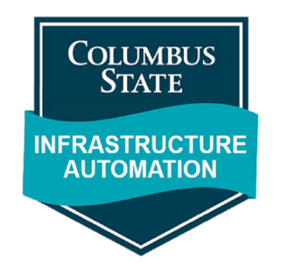
Infrastructure Automation Program
Current registration happening now in partnership with Columbus State Community College
Build a real-world example of a deployment pipeline using Automation, Testing, & DevOps principles
Outcome of the program is to be able to develop, troubleshoot, and problem solve in a cloud native environment using infrastructure as code and Kubernetes and orchestration.
Core Infrastructure DevOps Skills
Pre-requisite courses for the Infrastructure Automation Program
October 7
October 14
October 21
October 28
November 4
Git
Github & Github Workflow
Cloud Basics
Networking
Developer Tools and Mindset
Open to all Nationwide Technology Associates
Notes:
Add the other learning

Slide 34
Created a Financial Model (FINSIM) to Unitize our Products for Transparency in Cost and Recovery
Consumption Reporting System (CRS) supports entire process from beginning to end (like today)
3
1
Total Expense of a single product
4
4
Variance from budgeted and actual consumption reporting monthly; includes consumption forecast
Actual
Consumption
Variance
Analysis
Budgeted Consumption Allocation
If variance analysis changes meet threshold, update allocation drivers (timing TBD)
2
Consumption set for the budget based on usage as of Jun 1 (e.g.)
2
5
Consumption
Drivers
Updated
Allocation
5
3
Usage based on actual monthly consumption
Total Cost
of Product
6
Any cost remaining after updates is sent to stranded cost (process TBD)
Stranded Cost
1
6

Slide 35

Organized Product Teamwork for Transparency & Focus
Product Team X
External Demand
Business needs from Infrastructure teams
Tracking Areas of Product Expense.
Technology Team Needs
Security Office Requirements
New Product Start up (Kafka example)
Product Consulting*
Track Product Consulting Spend
Product Evolution
(funded by I&O in
Unit Cost of Product)
Track Product Consulting Spend
Drivers of Product Unit Cost
Product Investments (Project Breakdown)
Product Operations (keep lights on)
Incident
Patching
Minor Upgrades
Consumption Mgmt
User Feedback
Metrics
Start with one bucket breakdown Later
*In future, do not embed Product Consulting in Unit Cost

Slide 36
Transforming How We Deliver
Defining and Collecting Best Practices to Guide Product Teams
Defining & Collecting Best Practices (The How Playbook)
Playbook of Best Practices
IAM Pilot
Measures & Metrics – MTRS/MTTR for speed
Full Product Team Rollout/ Adoption
Build User Empathy and Design Feedback Loops
Defining and Collecting
Best Practices
(The How Playbook)
Building a Foundation
Organizing for
Product
Implementation
Understanding our
Product Values
(The Why)

Slide 37







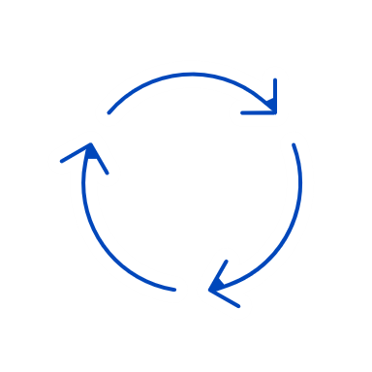












Playbook of Best Practices for Lean+Agile+DevOps Adoption
Foundational - 2020
2021
Continuous Integration &
Continuous Delivery for Infrastructure
Product Focus
Team Collaboration
Do All the Things Iterative
Version Control Everything
Customer Collaboration in all we do
Ex. Feedback Loops
Continuous Flow
Product Monitoring
Adoption & Continuous Improvement
Release Frequency & Planning
2021
DevSecOps for Infrastructure
Automate All We Do
Measure & Metrics
Quality Management

Slide 38
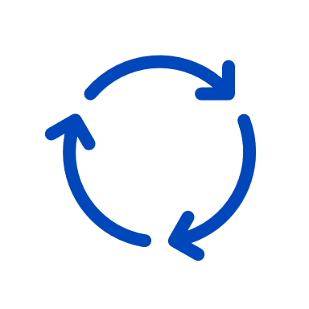





Pilot Successes
The I&O Product Model Pilot was initiated in Q1 2020 with the IAM product team with a focus on the following OKR’s:
OKR
Objective
Key Results
PRODUCT PRINCIPLES - FLOW
Establish a common vocabulary and inject use of enterprise tools – JIRA, Planview, Whoville to manage and make visible all work execution – “Learn by Doing”. Categorize workflow by Product Category
Enterprise tool adoption with JIRA (product boards), Planview and Whoville with FLOW concepts injected end to end
Product vocabulary established and codified in online reference
4 Quadrant Product Model implemented for workflow categorization
All allocation exists in Planview with a defined mechanism for external demand recovery
Product Owners\prioritization defined and bi-weekly backlog grooming sessions utilize Kanban pull system to move work to delivery
Three Big Room Planning sessions were completed – Retros driving CI
Enterprise IAM Multi Year roadmap in process
Velocity and backlog metrics are now reported and continuously improved
Metrics have been used for workforce decisions and FLOW priority decisions
STRATEGY
Ensure all work is entered into enterprise tools and consistently prioritized for delivery
Define a multi year roadmap and utilize Big Room Planning to efficiently and effectively plan 30/60/90 release commitments and alignment
PORTFOLIO / PRODUCT
Develop, track and report standardized FLOW metrics for release, demand, cycle time and workforce planning
TEAM

Slide 39
Transforming our Portfolio Management Practices
The Quarterly Technology Planning was initiated to help us manage our portfolio across the Product Suites
Design Process
Portfolio and Delivery Management Process
Execute 1st QTP
Quarterly Technology Planning Session
Develop Portfolio
Create I&O Portfolio
in Planview E1
Prioritize Portfolio
Prioritize Portfolio
in Planview E1
Establish guidelines for funding sources
1st Quarterly Technology Planning Session was held in 4th quarter in 2020.
Use to review detail dept discretionary and non discretionary investment .
Scheduled every quarter for 2021
Create Portfolio List (based on sub-portfolios)
Prioritize initiatives within each L5 sub-portfolio
Establish guidelines for funding levels
Categorize the type and source of funding
Input from L4 aligned TDL(s)
Prioritize the initiatives across the L4 sub-portfolios
Establish delivery management practices
Implement delivery management practices
Identify “Big Hitters” for QTP
Product Teams to identify initiatives to get them to goal state on their technology product roadmaps; prioritize importance within and across the sub-portfolios
Technology Delivery Product Support Team will define processes and establish guidelines; partner with L4 aligned TDL(s) in portfolio development and prioritization efforts
I&O Cabinet

Slide 40
Driven by Empathy | Create Feedback Loops
Evaluate Performance Improvement
Discover Issues
Evaluate Performance Improvement
Discover Issues
Evaluate Performance Improvement
Discover Issues
Self or Assisted
Cross-Product
Product
Delivery
Practices
Commit To Action
Analyze Causes & Consequences
Commit To Action
Analyze Causes & Consequences
Commit To Action
Analyze Causes & Consequences
Create Options & Solutions
Create Options & Solutions
Create Options & Solutions
For the purpose of:
For the purpose of:
For the purpose of:
Portfolio Prioritization
Organizational Effectiveness
Cross-Product Improvement
Product Evolution
Strategy Development
Product Improvement
Opportunity Identification
Backlog Prioritization
Delivery Improvement
What
What
How

Slide 41





Customer Feedback Loop Framework
Objective:
To Produce “value added” solutions to problems.
To produce “value added” solutions to problems you need to know what the problem is
To know what the problem is you need to listen and observe
To truly listen and observe you need humility, empathy and curiosity
Humility
Empathy
Curiosity
MINDSET
Improving experience
Backlog Grooming
CI Commitment
Feedback Loops
Continuous Improvement Processes
Producer
Consumer
Inside Out Perspective
Outside In Perspective
CONTINUOUS IMPROVEMENT
MODELS
Communication (Product)
Surveys, Forums…
Direct Communication
Design Thinking
Empathy Maps
Persona
Note: This model is a starting point for us to pilot within IAM. Once put in practice we will use the feedback to make any necessary improvements.
MECHANISMS

Slide 42
Tooling to Support Transformation
I&O Transformation Design & Execution
Tooling to Support Transformation
Planview Optimization
Big Room Planning
Jira for Workflow Management
ServiceNow
Jira Defect/Quality Management
Tooling to
Support Transformation
Defining and Collecting
Best Practices
(The How Playbook)
Building a Foundation
Organizing for
Product
Implementation
Understanding our
Product Values
(The Why)

Slide 43
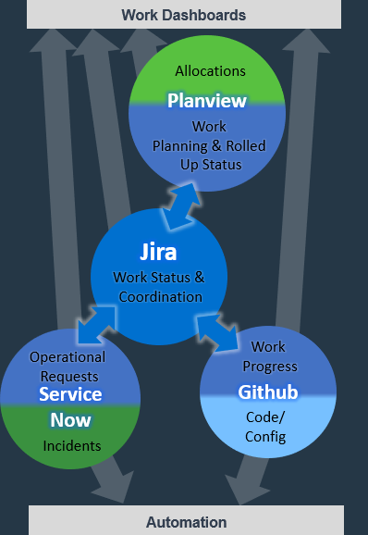
Standardizing our I&O work management approach across tools into one cohesive system
Jira as the common middle of work management
Coordinated and independent efforts requiring planning, prioritization, and coordination
Representation of all work to provide visibility and balance between team development efforts across all work types
Planview provides aggregate progress and allocation views
Team and individual allocations representing operational and engineering work
Work item breakdown, planning, team alignment, and progress spanning teams and areas
Epics flow down to Jira, aggregate status bubbled up to Planview
Development progress happens in Github, Operations in ServiceNow
Keep developers and engineers where their work is happening
Triggers of automation based on proximity to the necessary work
ServiceNow the tool to manage expedited handling of first-in/first-out type efforts requiring minimal planning & coordination, aggregate status bubbled up to Jira
Development and configuration work executed and managed locally in Github, aggregate status bubbled up to Jira

Slide 44








Continuous Flow
Elements of Flow
Flow Items | Examples | Driven From | Tool
Features | New business value, Enhancements | Product Portfolios, Product Evolution | Planview
Quality | Defects, Known Errors | Quality Engineering | Service Now, JIRA
Risks | Security, governance, compliance | Audit Items, IRM Risk Items, Vulnerabilities | ARCS, Service Now VM
Technical Debt | Removal of impediments to future delivery | Currency, Upgrades, Technology Product Roadmaps (TPR) | TBD/Service Now
Continuous Improvement (CI) | Process Updates | Retrospectives, Team Generated | JIRA
Team Generated Continuous Improvement (CI) Work
Portfolio or Product Technology Initiatives
Epics
JIRA
Work Status &
Coordination
Work Progress
Github
Code / Config
Big Room Planning
Work Planning & Rolled-Up
Status
Product Epic
Decomposition
Backlog
Product Team(s) Complete Story Card Development & Prepare for Deployment
e.g. Known Errors, RFS
Stories
Stories
Stories
Backlog
Grooming
Operational Requests
Incidents
Flow
Metrics
Flow
Metrics
e.g. RFC, Incident, RFS
First Time Final
Process
Tool Activities
Input Item
Flow Metrics

Slide 45
Transformation Approach
I&O Transformation Design & Execution
Transformation Approach (Coaching/Dojo/
Self Service, etc.)
Tooling to
Support Transformation
Transformation Approach (Coaching, Dojo, Self Service, etc.)
Defining and Collecting
Best Practices
(The How Playbook)
Building a Foundation
Self Service
Dojo Coaching Support
Sustainability
Best Practices Training
Organizing for
Product
Implementation
Understanding our
Product Values
(The Why)

Slide 46

Product Model Support
Facilitated Training
Product Model Champions/Technology Delivery Professional Guild
Associate led Agile Mindset Training
Leader Series (each Best Practice)
Teaching Thursdays
External Agile Training
Certified Agile Leadership (CAL) CSCC Infrastructure, Automation, & DevOps Training
PMC - Representative(s) from each L4 leader to support self-service adoption of each best practice
TDP Guild – monthly collaboration of all associates fulfilling TDP role & responsibilities (TDPs listed for each team in Whoville)
Self-Service Resources
Dojo/Consulting
Product Model Playbook
Product Centric SharePoint Site
Adoption Model and Adoption Roadmaps (Whoville)
Adoption Metrics
Leverage Product Model Champions/TDPs
Internal training (e.g., iDrive/LinkedIn Learning/Pluralsight)
Associates can ask questions through Answer Hub
4 days/week – reserve Fridays for vacations/catch up
Week 1 will be focused on the management role in Product Model Adoption for each topic
Weeks 2-X (length determined as needed based on Dojo Topic) will focus specifically on each topic for the # days required
Product Managers can request Dojo Support through Answer Hub
Transformation Approach (Coaching/Dojo/
Self Service, etc)
Tooling to
Support Transformation
Defining and Collecting
Best Practices
(The How Playbook)
Building a Foundation
Organizing for
Product
Implementation
Understanding our
Product Values
(The Why)
Notes:
Heather

Slide 47
Product Stack Full Analysis drives Product Savings
I&O Transformation Design & Execution
Continuous
Improvement
Transformation Approach (Coaching/Dojo/
Self Service, etc)
Tooling to
Support Transformation
Defining and Collecting
Best Practices
(The How Playbook)
Building a Foundation
Organizing for
Product
Implementation
FULL STACK ANALYSIS
Understanding our
Product Values
(The Why)

Slide 48
Full Stack Product Analysis | Storage
Software
Virtana
DellEMC
Hardware
Opportunities
$1.1M
STORAGE TRANSFORMATION
Object Storage Optimization
DPS/Backup Strategy
Storage Network Refresh
Block
IBM
Pure
Pure
DellEMC
Storage Network
Cisco
Software
DellEMC
Cohesity
File
Storage Technology
Hardware
Labor Expense (allocated across Products) via Planview
DellEMC
DellEMC
Labor & Non-Labor Product Expense
Software
DellEMC
Object
Hardware
DellEMC
Software
Veritas
DellEMC
DPS
Hardware
DellEMC
New
Fixed Contract
Depreciation
Consumption Based Contract

Slide 49
Full Stack Product Analysis | Network
Automation / Orchestration
DNAC
Algo Sec
Net MRI
Labor
Net Management
Observability
CA
Perf Center
Netcool / ITNM
Gigamon
Thousand
Eyes
Live Action
UDP
Rsyslog
Opportunities
$0.4M
Firewall rule Simplification
Edge Sec
Edge Security
Pulse Secure
iBoss
BPE
F5/WAF
Labor
Load Balancing & Firewall
Palo Alto/NGFW
F5
Cisco ASA
AdvThreat
Labor
Core Security
Equipment (EDP/SW) : /Internal Labor – 65 FTE (Sal/Bene)
External Labor (Ext Svcs & Cons)
Network
Services (DDI, etc.)
InfoBlox
NTP$
Connectivity
MPLS
DIA
P to P
Core/UVN
ISP
BB + MISC
Cloud/NB
DDOS Scrub.
Labor
Core
Cisco Nexus
ASR/ISR
SD-WAN
DWDM
Cologix
Equinix
Labor
Core & Campus
Campus
Cisco Catalyst
Cisco ISE
Cisco Wireless AP
Cellular DAS
Labor

Slide 50
Full Stack Product Analysis: Container – 2021 Growth
Entire Stack is Consumption Based
Total Stack
Assumptions:
Growth continues as per projection projects from migrations and past trends
Closing gaps on storage and license is still important to understanding total cost to BSA for stack components
Network
Load Balancer
VPC
Direct Connect
Rancher
Expense Reduction Opportunities
$0M
Growing Product, no expense reductions opportunity, maintaining unit cost
Investing as a go forward technology
Moving away from Docker
Registry
(Nationwide Trusted Registry)
Platform Logs & Performance
Support & License
Management Servers (3x)
Master & Worker Nodes
Compute
Storage

Slide 51
Labor Related Product Opportunities and Recommendations
Organized & aligned full stack product Teams – shifted and converged teams
Reduction in orchestration roles (PM, etc.)
Addressed geographic dispersion of associates
Addressed separated off-shore teams doing Run only functions
Eliminated independent fulfillment teams (30 resource savings)
Created TDP engineering roles for product teams for delivery focus
Enabled an increase in span of control for managers (10-15)
Thus, reduced manager footprint (Harvested Manager Openings)
Aligned some separated Run Services (ECC Mainframe)
Aligned architects to product orientation
Removed 8th layer cross product general executive oversight (executive savings)
Simplified partner solutions in support of product orientation
Increased SRE support to enable product teams
Network labor reductions from firewall rule simplification

